Slide 1
Capstone Project: Battle of the Neighborhoods
Kanika Bhardwaj

Slide 2
Introduction: Business Problem
In this project we will try to find an optimal location for an art gallery. Specifically, this report will be targeted to stakeholders interested in opening an art gallery in Paris, France.
Since there are lots of art galleries in Paris we will try to detect locations that are not already crowded with art galleries. We are also particularly interested in areas with no sculpture galleries in vicinity. We would also prefer locations as close to the city centre.
We will use our data science powers to generate a few most promissing neighborhoods based on this criteria. Advantages of each area will then be clearly expressed so that best possible final location can be chosen by stakeholders.

Slide 3
Methodology
In this project we will direct our efforts on detecting areas of Paris that have low restaurant density, particularly those with low number of Italian restaurants. We will limit our analysis to area ~5km around city center. In first step we have collected the required data: location of every art gallery within 5km from Paris center. We identify the Paris center to be the area around the Louvre museum(also called the 1st Arrondissement). We believe that this is the optimal centerpoint because it is where the majority of tourists spend most of their time. This is of particular interest for the stakeholders since it increases their chances of maximizing their revenue.
Second step in our analysis will be calculation and exploration of 'art gallery density' across different areas of Paris - we will use heatmaps to identify a few promising areas close to center with low number of art galleries in general and focus our attention on those areas.
In third and final step we will focus on most promising areas and within those create clusters of locations that meet some basic requirements established in discussion with stakeholders: we will take into consideration locations with no more than three restaurants in radius of 300 meters. We will present map of all such locations but also create clusters (using k-means clustering) of those locations to identify general zones / neighborhoods / addresses which should be a starting point for final 'street level' exploration and search for optimal venue location by stakeholders.¶

Slide 4
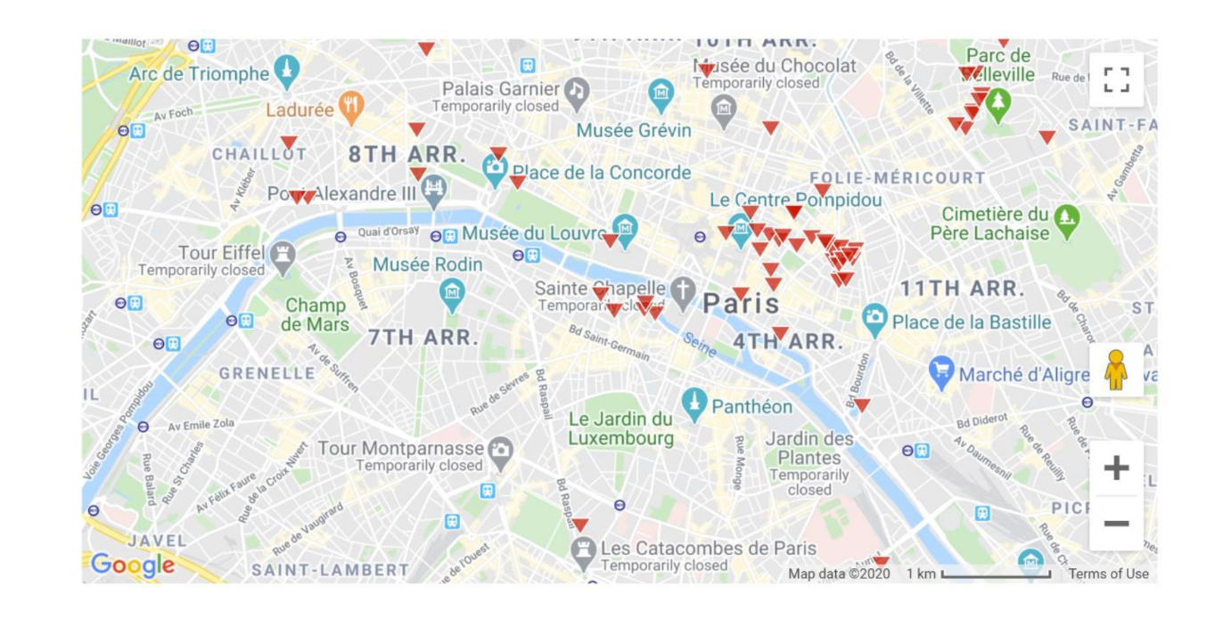
Due to an error with javascript in watson studio, the map generated with folium cannot be shown in the notebook. This is a similar map from Google for reference:

Slide 5
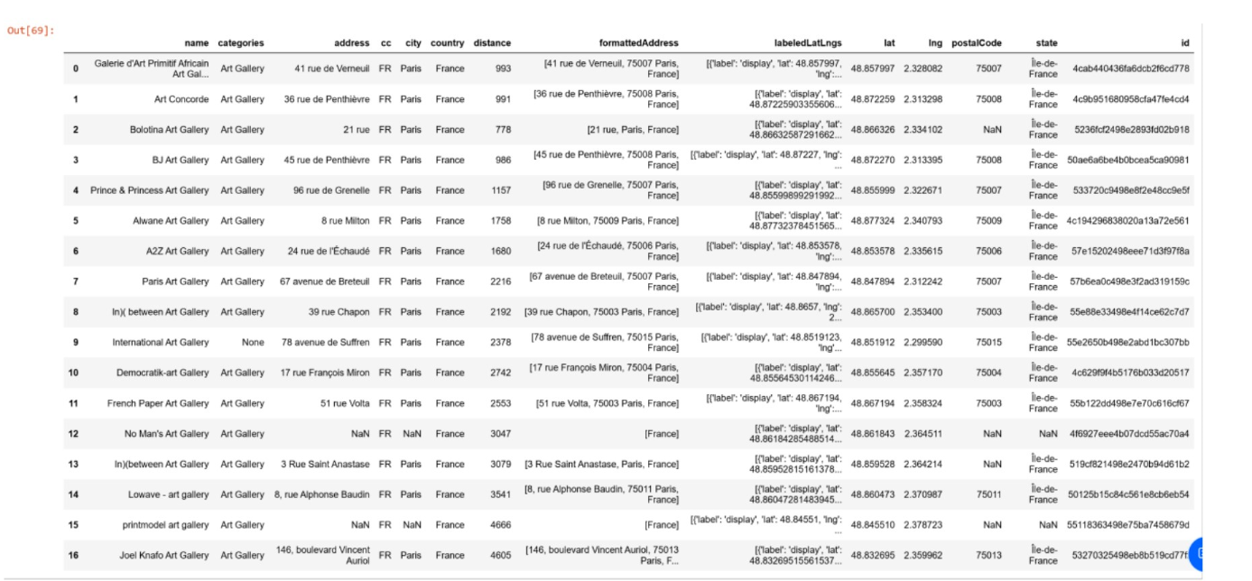
Analysis

Slide 6
Results and Discussion
We can see that, according to Foursquare data, the small number of art galleries found in the key area
(5km within the Louvre) means that our stakeholders will not be faced with overwhelming competition.
This is true no matter where they may choose to open their art gallery, since only 17 such galleries exist
in the area that concerns them.
Conclusion
In conclusion, the project has found valuable information for the stakeholders. They had expected a very
high number of art galleries to be found in the area most tourists visit when they go to Paris, but instead
they found a very low number of competitors.
This means they are likely to be successful in their business

Slide 7
THANK YOU

